Slide 1





Course Name object oriented analysis and design
CSC 2210
(Undergraduate)
Software engineering (Undergraduate)
Chapter 5 activity diagram
M. Mahmudul hasan
Assistant Professor, CS, AIUB
http://www.dit.hua.gr/~m.hasan

Slide 2
process
OOAD : Activity Diagram
M. Mahmudul Hasan
OOAD : Activity Diagram
M. Mahmudul Hasan
S.2
MMH
A process is a collection of related tasks that transforms a set of inputs into a set of outputs.
Process description notations describe design processes as well as computational processes we design.
An activity is a non-atomic task or procedure decomposable into actions.
An action is a task or procedure that cannot be broken into parts.

Slide 3
Activity diagram
OOAD : Activity Diagram
M. Mahmudul Hasan
S.3
MMH
Describes activities and flows of data or decisions between activities
Provides a very broad view of business processes
Can be used to break out the activities that occur within a use case
Commonly shows many different activities that will be handled by lots of different symbols
Good for showing parallel threads
Activity diagrams can be used in conjunction with other modeling techniques such as interaction diagrams and state diagrams

Slide 4
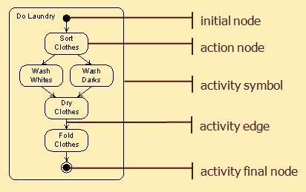
Activity graph elements
OOAD : Activity Diagram
M. Mahmudul Hasan
S.4
MMH

Slide 5
Execution model
OOAD : Activity Diagram
M. Mahmudul Hasan
S.5
MMH
Execution is modeled by tokens that are produced by action nodes, travel over action edges, and are consumed by action nodes.
When there is a token on every incoming edge of an action node, it consumes them and begins execution.
When an action node completes execution, it produces tokens on each of its outgoing edges.
An initial node produces a token on each outgoing edge when an activity begins.
An activity final node consumes a token available on any incoming edge and terminates the activity.

Slide 6
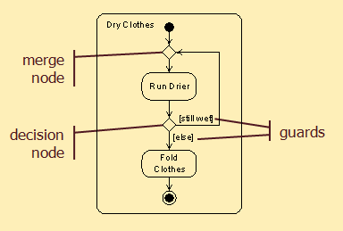
Branching Nodes Execution
OOAD : Activity Diagram
M. Mahmudul Hasan
MMH
S.6
Incoming -2
Outgoing - 1
Incoming -1
Outgoing - 2

Slide 7
Branching Execution
OOAD : Activity Diagram
M. Mahmudul Hasan
S.7
MMH
If a token is made available on the incoming edge of a decision node (join if…else condition), , the token is made available on the outgoing edge whose guard is true.
Guards must be mutually exclusive (the outgoing signal is transfer to either true or false, but not both)
If a token is available on any incoming edge of a merge node (join parallel actions), it is made available on its outgoing edge.

Slide 8
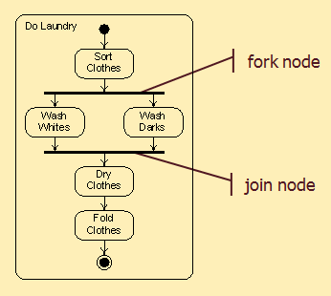
Forking & joining nodes
OOAD : Activity Diagram
M. Mahmudul Hasan
S.8
MMH
A token available on the incoming edge of a fork node is reproduced and made available on all its outgoing edges.
When tokens are available on every incoming edge of a join node, a token is made available on its outgoing edge.
Concurrency is modeled of these nodes.

Slide 9
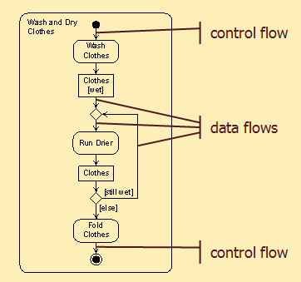
Object nodes
OOAD : Activity Diagram
M. Mahmudul Hasan
S.9
MMH
Data and objects are shown as object nodes (represented by noun and its state in a rectangular box)
Control tokens do not contain data, data tokens do.
A control flow is an activity edge that is a channel for control tokens.
A data flow is an activity edge that is a channel for data tokens.
Rules for token flow through nodes apply to both control and data tokens, except that data is extracted from consumed tokens and added to produced tokens.

Slide 10
Activity diagram heuristics
OOAD : Activity Diagram
M. Mahmudul Hasan
S.10
MMH
Flow of control and objects goes down the page and from left to right.
Name activities and actions with verb phrases.
Name object nodes with noun phrases.
Use the [else] guard at every branch.
When to Use Activity Diagram
When making a dynamic model of any process.
Design processes (what designers do)
Designed processes (what designers create)
During analysis
During resolution (decision)

Slide 11
references
OOAD : Activity Diagram
M. Mahmudul Hasan
S.11
MMH
Booch, G., Rumbaugh, J. & Jacobson, I. (2005). The unified modeling language user guide. Pearson Education India.

